Slide 1
Samples and Census
EQ: what is the difference between Samples and Census.

Slide 2
Sample and census
When collecting data, we will gather our data through either a census or a sample.
A sample is information gathered from a small population of people.
A sample is not gathered from the whole population
A sample provides a window into the overall population
A census is a survey of an entire population.
A census is conducted every 5 years in Australia.
They survey every single household about their job, income, religion, education and net worth.
The census is conducted by the Australian bearue of Statistics.

Slide 3
Sample and census
There are many Positive and Negative attributes to both sample and census collecting:
 | Positive | Negative
Sample | Quick Low/no cost | Bias Not a true representation of population
Census | Whole population surveyed Accurate data No bias | Expensive Time consuming

Slide 4
Sample and census: Practise
Identify the following as either a sample or a census.
Surveying the class about their favourite ice-cream flavours
Survey – its in the name
Asking the class if they like Harry Potter movies
Survey- it is only the class
Asking all Year 11’s in Australia their favourite subject and their shoe sizes?
Census – we asked all of the group of year 11’s
4) Digitally surveying all households of income and religion
Census- this is what the ABS does to this day
5) Asking all of your friends favourite Colour, Movie Genre’s
Census – because you have asked ALL of the people you consider friends, you have conducted a census.

Slide 5
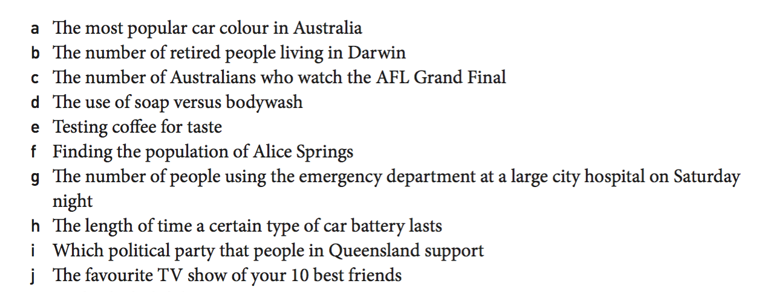
Which would you use?
Would you use a Sample or Census for each of these?

Slide 6
Sample types
There are 4 sample types:
Random:
Selecting random people, or using a random number generator to select a sample of people.
Eg: Rolling a die and after giving everyone a number, using then selecting that person from the dice roll.
Stratified:
Where you select an appropriate proportion of a population based on Percentage make up
Eg: If there are 40 year 7’s and 100 year 8’s, for a sample of 20 you want 5/6 year 7’s and then 15/14 year 8’s. These are representative or the size of each group.
Self selected:
Opt in surveys were people will ask you for your thought or
Systematic:
Selecting people using a system to determine who is being chosen.

